Slide 1
Diversity, Equal Opportunity, and Nondiscrimination
Annual Refresher Training
Notes:
2020 edition

Slide 2
Commander’s Intent
CAP provides an inclusive and welcoming environment for all members and ensures that educational, membership, and operational decisions are based on each individual’s abilities and qualifications.
The opportunity to participate and progress is limited only by a member's ability, participation, and performance.
Commanders at all levels are responsible for ensuring that members under their command are aware of and adhere to CAP’s nondiscrimination policy.
Notes:
First and third bullets are verbatim from annual CC EO memo (2020)

Slide 3
2020-2024 Strategic Plan
Goal 4. Model volunteerism and servant leadership as a respected nonprofit that embraces the power of diversity and inclusion.
Diversity is a critical component of successful organizations. Ensuring that an organization embraces, seeks and celebrates diversity brings richness to the organization.
Diversity of thought, gender, ethnicity and age makes the organization stronger.
A key factor to achieving broad diversity is having an organization that is inclusive – all members have the same opportunity to participate, to be valued and to be successful.
Each member joins CAP for a different reason. Just like the diversity in our membership, so too is the diversity in the contributions each one makes, the levels they may attain in CAP and the satisfaction each receives by being a member.
Notes:
New slide to tie-in to Strategic Plan to show alignment with CAP's highest priorities.

Slide 4
CAPR 36-1, Civil Air Patrol Nondiscrimination Program states:
“It is CAP policy that no member shall be excluded from participation in, denied the benefits of, or subjected to discrimination with respect to accessibility to any CAP program or activity on the basis of race, color, sex, age, religion (creed), national origin (ancestry), sexual orientation, gender identity or expression, disability (formerly handicap), marital status, military or veteran status. However, each case is subject to applicable qualifications and ability standards for the CAP program or activity concerned. Further, it is Civil Air Patrol policy that no applicant meeting CAP’s minimum age requirement will be denied membership in CAP on the basis of any of the foregoing characteristics.”

Slide 5
Nondiscrimination
CAP’s non-discrimination policy is based on public law as well as the Department of Defense and the United States Air Force policies. Several key laws and policies are outlined in CAPR 36-1.
Additionally, CAP has four core values: Integrity, Volunteer Service, Excellence, and Respect that serve as a guide for members to follow in the performance of their duties.
By adhering to the policy of non-discrimination, these core values are supported, but it is the value of Respect that closely aligns with non-discrimination because its focus is on how we treat others.
According to Lexico.com, respect means “due regards for the feelings, wishes, or rights of others.” When we adhere to the non-discrimination policy and only consider relevant factors for membership or participation, we are respecting each person as an individual.

Slide 6
An Integrated Approach
In addition to the Equal Opportunity compliance program, CAP has added a focus on diversity and inclusion.
These complement, but remain separate and distinct from, CAP’s Equal Opportunity compliance programs and activities.
All three are essential if CAP is to stay competitive in attracting, recruiting, and retaining America’s best talent. When a potential member sees a diverse membership, they can see themselves being welcomed and thriving in the organization.
Members who feel their diversity is valued will want to continue to participate and support the organization, the membership, and the mission.
Notes:
Changed title from "Equal Opportunity Program" since that is only one of the three topics, transitioning from EO to D&I
Removed "s" from "complements"
*Text seems small. Can font be increased?

Slide 7
Diversity
Diversity and inclusion can mean different things to different people and organizations.
For CAP’s purposes, diversity is a composite of individual characteristics, experiences, and abilities consistent with the CAP Mission and Core Values and reflective of the communities in which we serve.
Civil Air Patrol diversity includes but is not limited to: personal life experiences, geographic background, socioeconomic background, cultural knowledge, educational background, work background, language abilities, physical abilities, philosophical and spiritual perspectives, race, color, sex, age, religion (creed), national origin (ancestry), sexual orientation, gender identity or expression, disability, marital status, and military or veteran status.
Notes:
Changed title to only include Diversity, since inclusion is not on this slide
Updated diversity definition to match approved version
Changed font size and expanded text box

Slide 8
Inclusion
Inclusion is the process of creating a culture where all members of the organization are encouraged to make their fullest contributions to the success of the group, and where there are no unnecessary barriers to success.
Every member shares responsibility for ensuring that the talents and capabilities of each individual are recognized, valued, and used toward enhancing mission accomplishment.
Notes:
Updated definition of inclusion to match CAP's definition

Slide 9
Strength in Diversity
Diversity is critical for strong support for our local communities across the United States.
We gain strength by leveraging the diversity of all members and creating an inclusive environment in which each member is valued and encouraged to provide ideas critical to innovation, optimization, and organizational mission success.
Notes:
Revised title from Diversity

Slide 10
Benefits of a Diverse Organization
Being true to our core values demands that we create a diverse and inclusive organization. Diversity makes our organization stronger and contributes to excellence in many ways.
For example, decision-making and operational capabilities are enhanced by diversity among our members, helping make CAP more agile, innovative, and effective.
It opens the door to creative solutions to problems and enables us to perform our missions better as they expand and increase in complexity. It assists in attracting, recruiting, and retaining volunteers.
Additionally, pursuing diversity encourages sharing the opportunities in CAP with more people across our communities, including youth who can benefit from the cadet program and adults who are looking for ways to serve.
Notes:
Expanded text box and increased font
Changed title
Indented second bullet

Slide 11
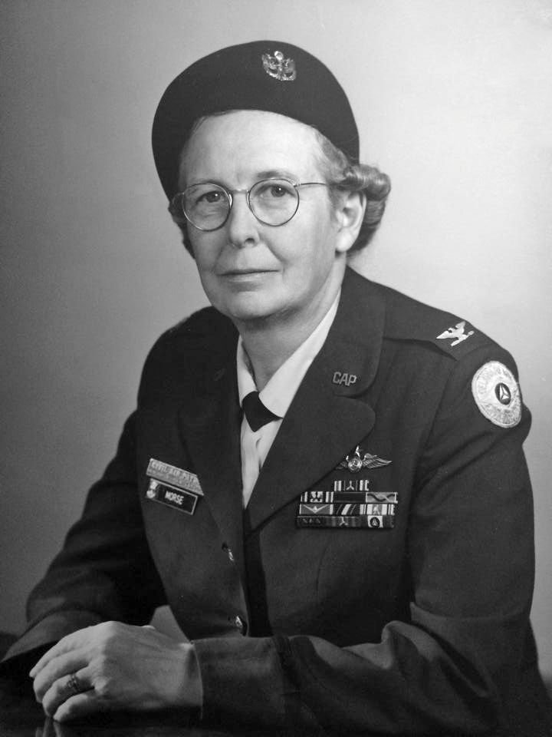
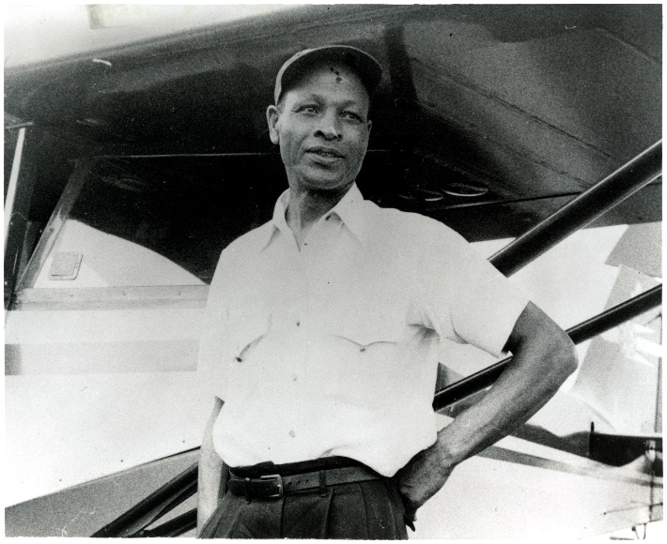
Diversity includes all of us, recognizing each member’s unique experience and enhancing the volunteer experience.
1st Lt Cornelius Coffey
Founded CAP's 111th Flight Squadron (ILWG)--first race and gender integrated, uniformed flying unit in American history
Designed a carburetor heater, similar designs still in use
Trained pilots for Tuskegee Airmen
Col Louisa Morse
Image courtesy of the Colonel Louisa S. Morse Center for CAP History
Colonel Louisa S. Morse
First woman on CAP's National Executive Committee
Middle East Region Commander, 1976-1979
Delaware Wing Commander for 23 years
Cornelius R. Coffey
Image courtesy of the National Air and Space Museum, Smithsonian Institution

Slide 12
Reasonable Accommodations
Reasonable accommodations are simply those modifications needed to ensure members with a disability have equal access to the rights and privileges of CAP membership.
An accommodation may also be made for other reasons, such as faith, dietary requirements, or gender identity.
Accommodations must be reasonable for the circumstances and cannot impose an undue hardship for the organization.
They cannot remove essential functions for the job requirement or program. They must be requested with adequate advanced notice (at least 30 days) to provide time to discuss options and adjust.

Slide 13
Reasonable Accommodations
Determining what is reasonable requires knowing what functions are essential to the program or activity. Essential functions are those necessary to complete the objective of a program.
This is codified in the non-discrimination policy, where it states that “each case is subject to applicable qualifications and ability standards for the CAP program or activity concerned.”
For example, a blind member could not serve as a scanner on a Search and Rescue aircrew because visually searching for a target is an essential job function.
They may, however, be able to serve as a radio operator if they can perform all essential functions with or without reasonable accommodations.

Slide 14
Accommodation Examples
The essential function required of the cadet drill test is to demonstrate proficiency of drill.
01
A reasonable accommodation for a cadet in a wheelchair could be to have them perform the moves they can (e.g., hand salute, modified attention) then explain the drill movements that they cannot perform.
02
In Achievement 4, only the cadet’s ability to call commands properly is being evaluated, so for this test, the cadet does not need an accommodation.
03

Slide 15
Accommodation Examples
A cadet with a learning disability may need additional time to read test questions to understand and choose the correct answer.
Allowing the cadet to take a paper version of the test and extending time limits could be a reasonable accommodation while still ensuring the cadet comprehends the materials.

Slide 16
Accommodation Examples
It would be reasonable for a cadet whose religious obligations forbids traveling on Saturday to arrive a few hours late for a week‐long encampment, if arrangements were worked out in advance.
If the member participates in 80% of the program, they will meet the essential requirements.

Slide 17
Uniform Waivers
In addition to making reasonable accommodations to the environment, members may request a waiver of uniform wear standards to wear neat and conservative religious apparel that may not be already authorized under the current regulations.
Additionally, CAP members who have evidence of a medical diagnosis of gender dysphoria may also request a uniform waiver to wear the uniform of the gender they identify with.
Notes:
Changed title to add Uniform
Changed icon

Slide 18
Requesting a Uniform Waiver
Refer to the CAP uniform regulation (CAPR 39-1) for a full description of the waiver process.
Note that waivers may be requested for the AF-style and corporate uniforms.
Members submit a waiver request by letter, including a photo or description of the item and explanation of religious need. Waivers based on gender must include a copy of evidence of a medical diagnosis of gender dysphoria along with any legal documentation surrounding name changes or gender reassignment.
Requests are submitted through the chain of command.
Notes:
Removed " at the time of this lesson was written" as that was a note due to the pending publication of CAPR 39-1
Removed "The written policy will be updated in the new regulation." Not needed now that the regulation has been published.
Changed "Note that waivers will be considered for the AF-style uniform." To "Note that waivers will be considered for the AF-style and corporate uniforms." Original text highlighted AF-style uniforms because the old manual didn't allow for waivers, yet CAP-USAF was approving it. This bullet could be removed altogether.
Removed "(through the commander at each level of CAP)" when mentioning chain of command in last bullet. That was put there for new members, since the target audience was Level 1.

Slide 19
Religious Accommodation Request
For requests for religious accommodations, the wing chaplain will interview the member (and, if a cadet, their parents) to assess whether the waiver is in keeping with the doctrinal or traditional observances of the member’s faith. The chaplain will provide a report to attach to the request. This interview should occur before the request gets to the Wing Commander.
Only the CAP/CC or CAP-USAF/CC can approve or disapprove a waiver request. Intermediate commanders may add a recommendation but must forward the request.
Some examples of waiver requests include wear of a hijab or turban and beard waivers when religious doctrine prohibits shaving.

Slide 20
Commander’s Responsibilities
Support reasonable accommodations
Ensure processes are transparent and consistent. Examples:
Selection process for a position is defined, shared, and followed
No additional skills added to ES qualifications unless based on local conditions and required of all trainees
Identify situations that could lead to discrimination
Take action at lowest level to resolve issues
Refer to EOO, if appropriate

Slide 21
Complaints under the Nondiscrimination Policy

Slide 22
Complaints under the Nondiscrimination Policy
CAP's Equal Opportunity Officer (EOO) shall be responsible for implementing a program for addressing the nondiscrimination concerns of and for the handling of all discrimination allegations/complaints that relate to CAP volunteer members.
If the non-discrimination policy is not followed and a member believes they have been discriminated against, they have the right to file a complaint under CAPR 36-2, Complaints Under the Civil Air Patrol Nondiscrimination Policy.
Notes:
Combined 23-28 into 3 slides
Title change to clarify under nondiscrimination
Added role of EOO

Slide 23
Requirements for Filing a Complaint
Only members, the parents, or legal guardians of cadet members under the age of 18 filing for the cadet member, or non-members alleging denial of membership due to discrimination, have the right to file a complaint under the non-discrimination policy.
All complaints of discrimination should be in writing, dated and signed by the complainant, and submitted within 60 days of the occurrence or action upon which the complaint is based or learning of the occurrence or action.
Notes:
Combined 23-28 into 3 slides

Slide 24
Contacting the Equal Opportunity Officer
Complaints may be submitted to the Equal Opportunity Officer (EOO) by email (eo@capnhq.gov), by mail, or delivered personally.
Contacting the EOO for assistance in determining if an allegation/complaint constitutes discrimination is not considered a violation of the chain of command.
No member shall be retaliated against or suffer reprisals for filing a complaint or participating in an investigation.
Notes:
Combined 23-28 into 3 slides

Slide 25
The previous requirements are just a summary of the process: members should review the entire process in CAPR 36-2 for full details.
Notes:
Design change

Slide 26
Resources
CAPR 36-1, Civil Air Patrol Nondiscrimination Program
CAPR 36-2, Complaints Under The Civil Air Patrol Nondiscrimination Program
National Commander's Nondiscrimination Memo
CAP Pamphlet 1-10, Suggested Best Practices for Including Individuals with Special Needs, for additional guidelines and examples on accommodations.

Slide 27
Conclusion
CAP’s non-discrimination policy is based on public law as well as the Department of Defense and the United States Air Force policies.
Every member shares responsibility for ensuring that the talents and capabilities of each individual are recognized, valued, and used toward enhancing mission accomplishment.
We gain strength by leveraging the diversity of all members and creating an inclusive environment in which each member is valued and encouraged to provide ideas critical to innovation, optimization, and organizational mission success.

